Slide 1
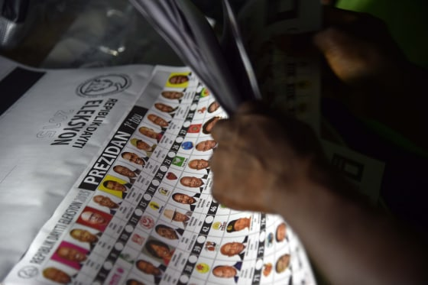
Project Solution Proposal

Slide 2
Hello!
I am Pierry Valcin
Finance | Data Scientist

Slide 3
Project Solution Proposal
In this presentation,we will tackle some issues about elections in Haiti . Our focus will be on :
How can political parties use data to plan an efficient budget for their campaign ?
How can they target more youth through the marketing campaign using data to build efficient strategies ?

Slide 4

Bad gouvernement are elected by good citizens who don’t vote
Unknow

Slide 5
What is the problem ?
Political Parties need to have a better understanding of the market. They need more data on the sector the will invest time and Money in
1

Slide 6

Political Parties Financing
Political parties can receive funding from :
Their partners
Fundraising activities
From the State (public funding)

Slide 7
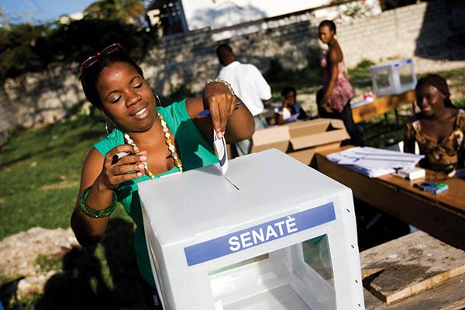
Political Parties Goals
Obtain more power/influence on the government
Seeks Political offices
Influence Public opinion

Slide 8
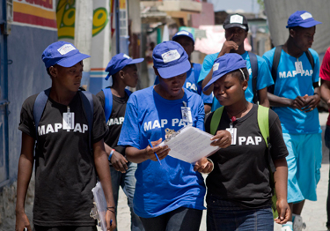
How can we solve this problem ?
What data we will need ?
Data about interest of the youth about politics
At what level has technology impacted their means of communication and life ?
What are their thoughts on the last political campaign they witness ?
.

Slide 9

How we will proceed to obtain these data ?
Survey
we will conduct a survey of at least 20 questions that will provide us with enough data to produce a meaningful analysis. We should get at least 100 observations.
Sharing
We will use social networks to share the questionnaire with google forms and to get the 100 responses.
Constraints
Due to lack of security and funding, we will not be able to do a field survey.
Our survey will be only online. The access to internet in Haiti is around 37.3% (source :https://www.haitilibre.com/docs/digital2021.pdf)

Slide 10
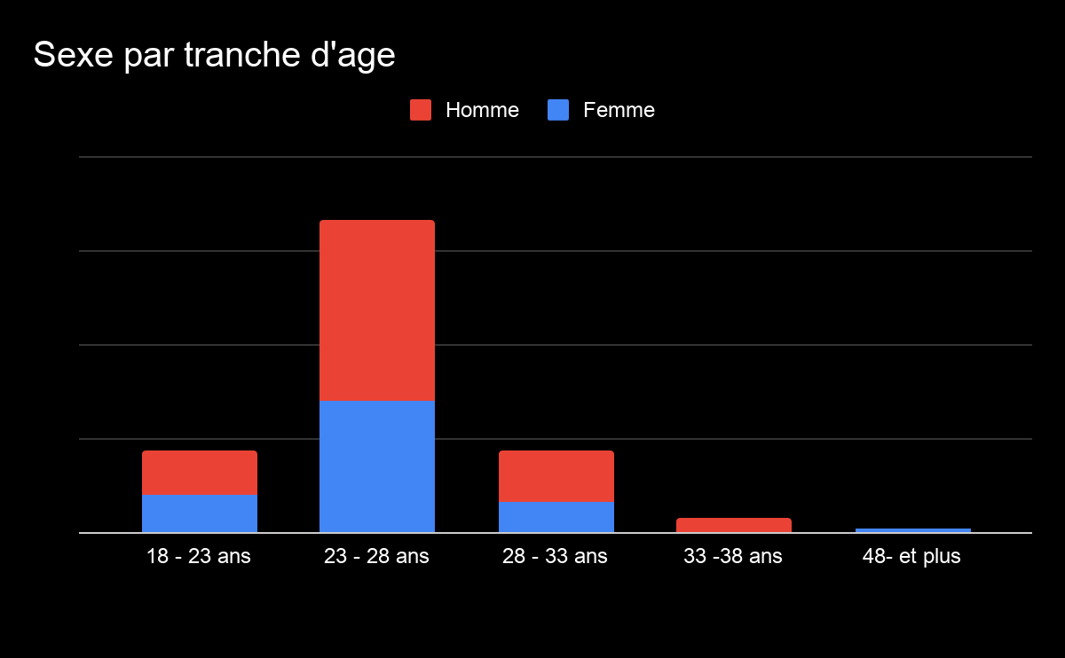
Survey
Our survey got 135 responses after 4 days on social networks. 80 men and 55 women all in the age range of 18 to 48 years.

Slide 11
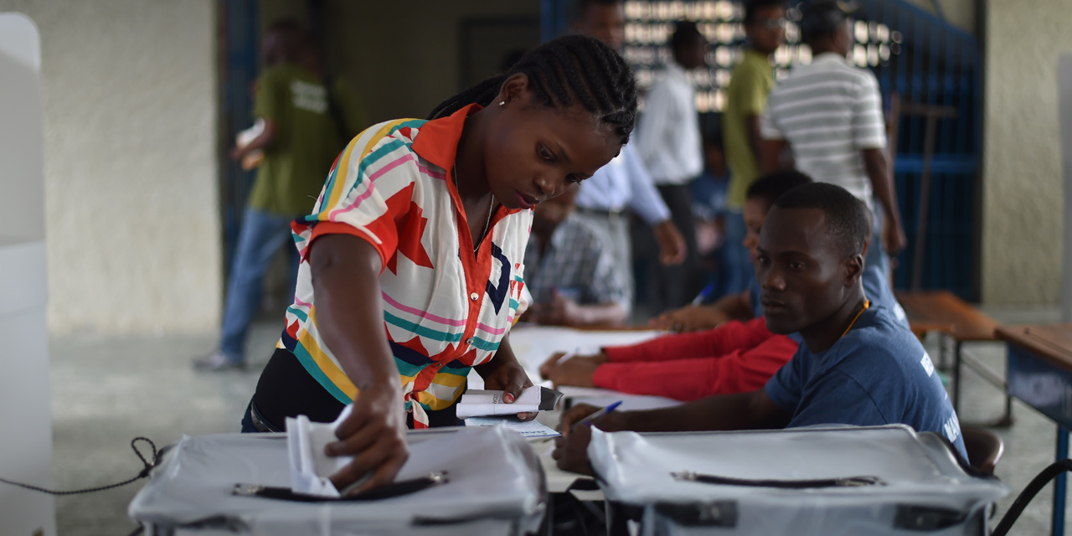
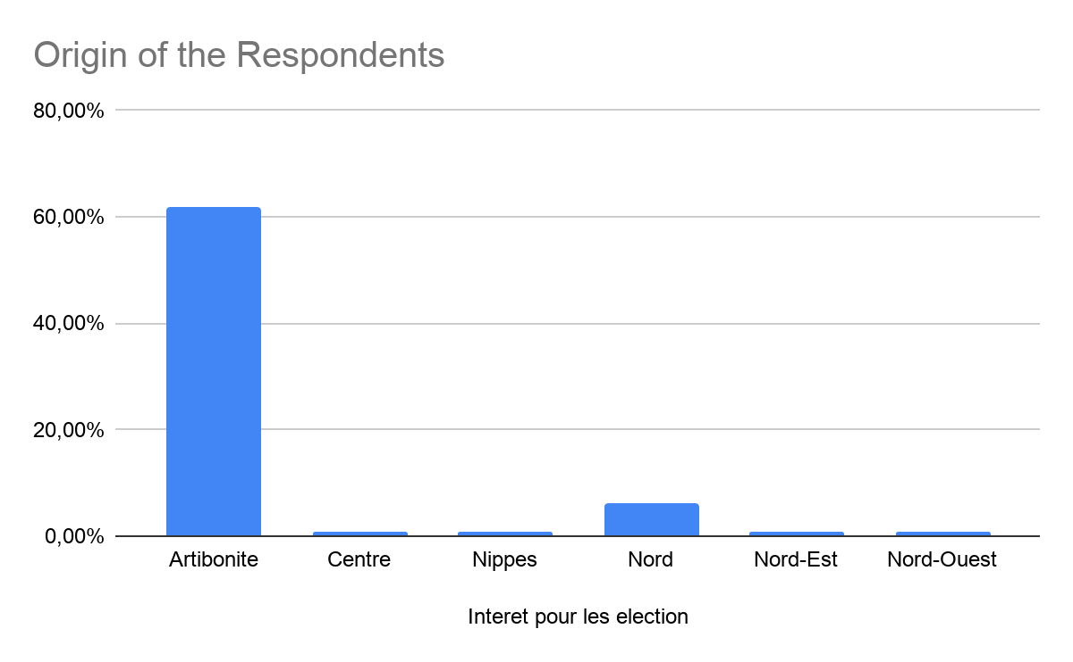
Origins of the respondents

Slide 12

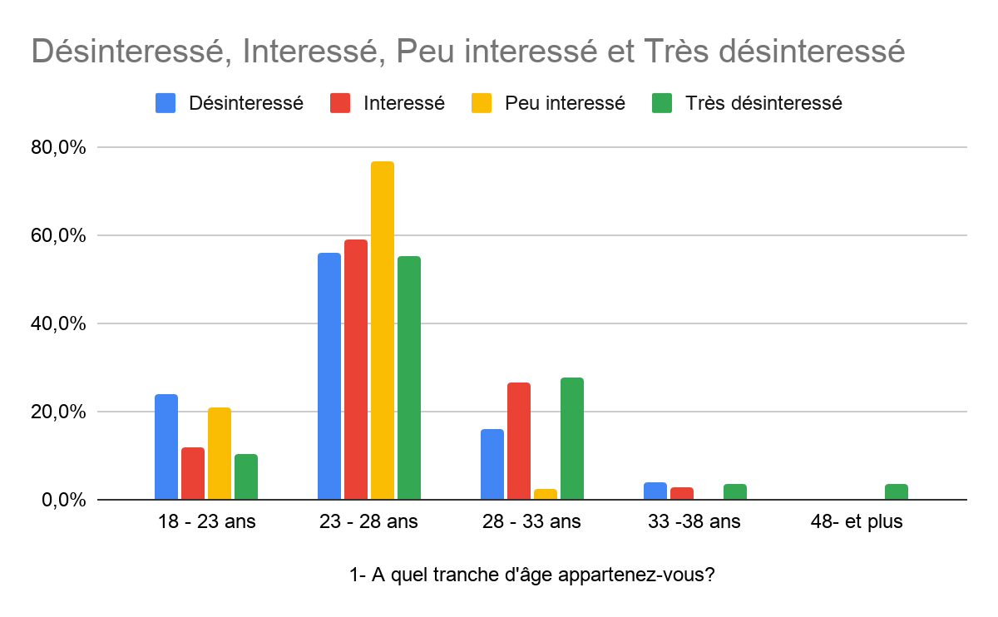
Interest of the respondents about politics

Slide 13
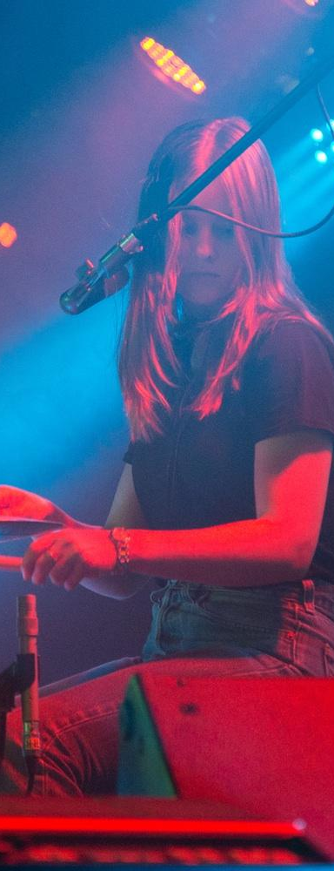
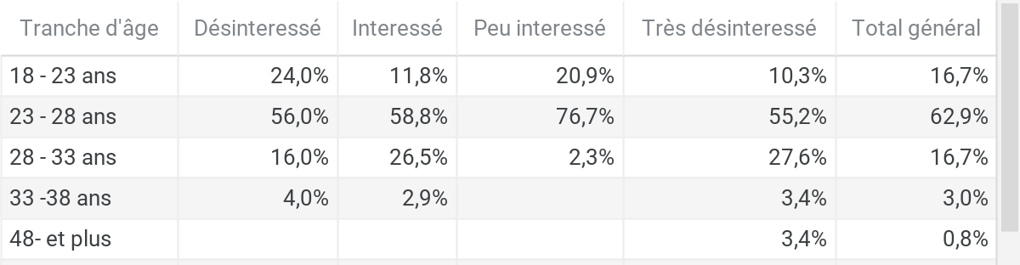
Table of proportion of disinterest by Group Age.

Slide 14
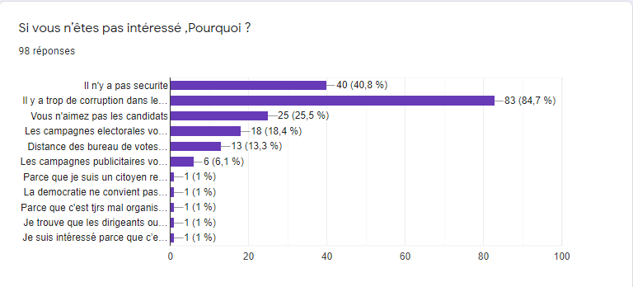
Reasons of disinterest

Slide 15
Reasons of disinterest
Corruption in elections. 80% of the respondent put it as a reason
No security | Distance from polling stations too far.
They don’t appreciate the Candidates.
They don't like how the campaigns are handled.
The posters dirty the streets.

Slide 16
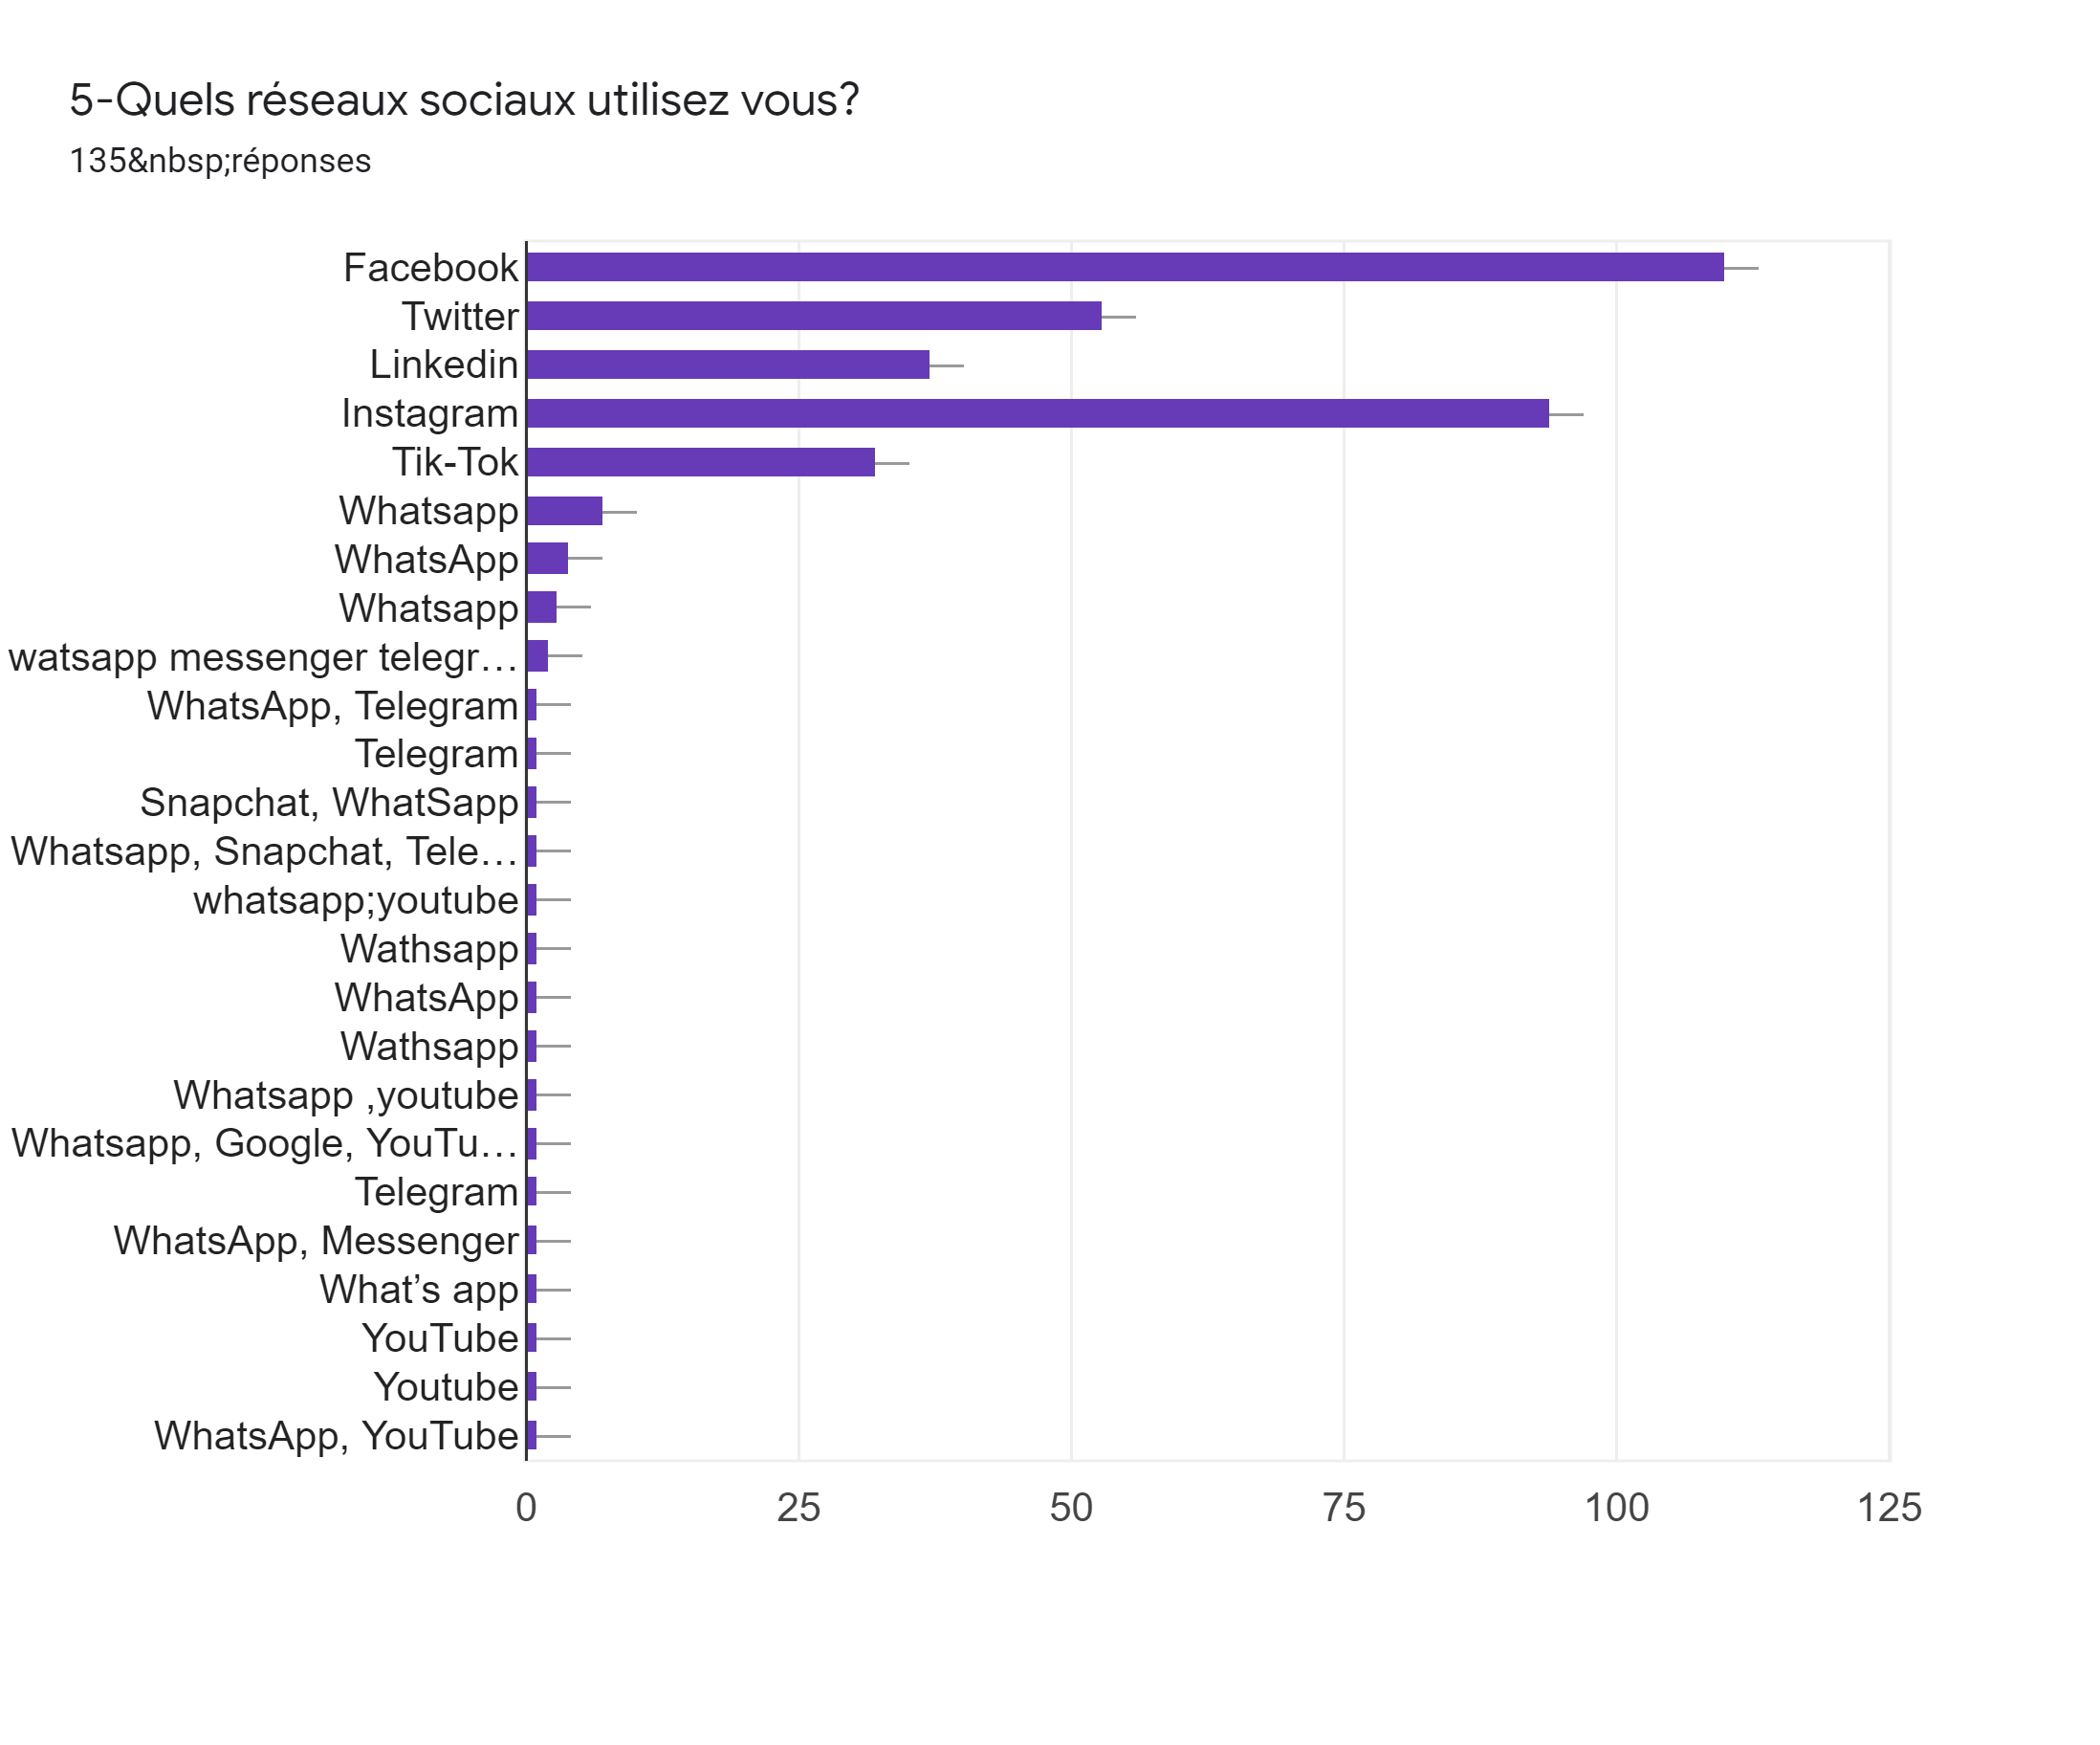
Presence on Social media

Slide 17
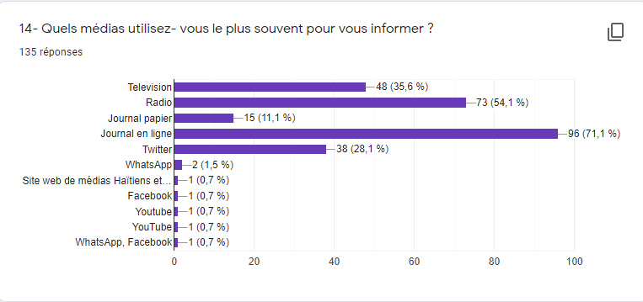
Media used for staying informed
More than 96 people who responded to the survey are informed through the online newspaper. The penetration of information through the Internet is very widespread.

Slide 18
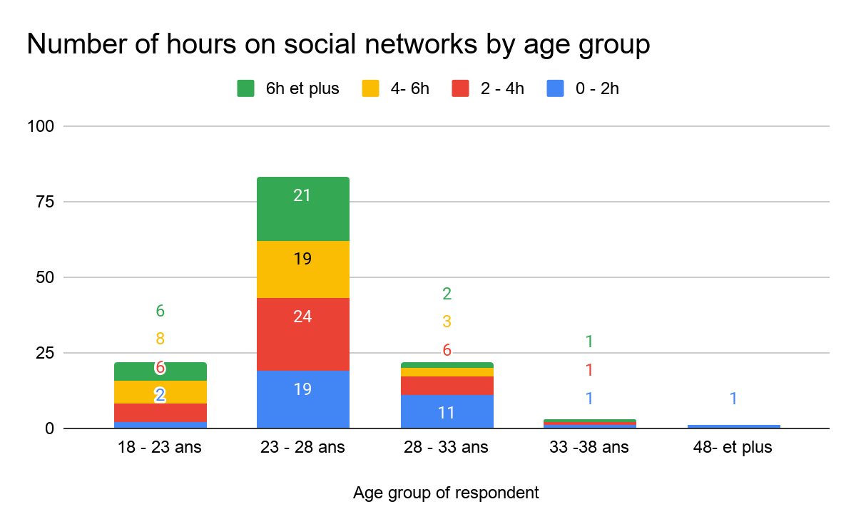
Time spent on Social Media

Slide 19
Social network
We can observe how the majority of young people who responded to the survey are present on social networks and spend a lot of time on them on average more than 50% of young people aged 23-28 years spend more than 4 hours and more on the networks.
More and more people started using Social network to inform themselves with online journal via twitter,facebook and their own website.
The radio remains very present as a means of information and is also modernized with podcasts and online listening on specialized sites .
Nowadays, The social media marketing is one of the main tools that can help you grow digitally and target more the youth.

Slide 20
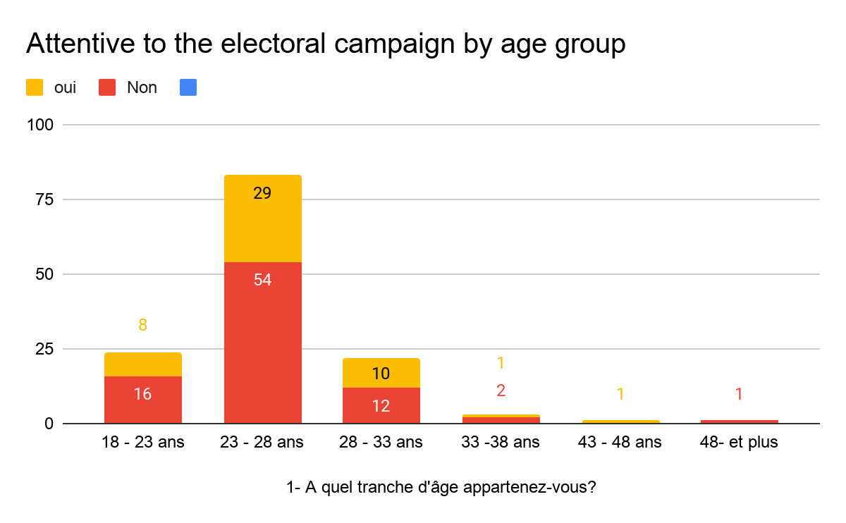

Slide 21
Reasons of inattention
63.43 % of the respondent are not attentive of the electoral campaign
43.63 % of the respondent who choose no find that there is unfair competition between the candidates
36.3 % respondents who choose no complain about lack of fair electoral debate

Slide 22
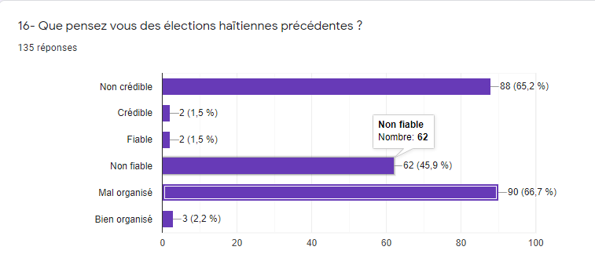
Thoughts about past elections

Slide 23
More than 65% of the respondent find that the past elections where poorly organized and also not credible
79.51% of the Age Group of 23-28 year old think that the past election was not credible, not fiable and poorly organized or either on one them.

Slide 24
Recommendations for Political Parties.
On the Marketing side.
The next elections in haiti, the digital presence of your candidates will be primordial. Less streets posters
We can’t target to youth without promotions on social media. As we see from the data we collected, the majority of the responders has access to social media and spent a lot of time on it
2. The majority of the respondent are disinterest in politics because of corruption at the elections, insecurity and do not like the candidates that does not inspire confidence.

Slide 25
Recommendations for Political Parties.
On the Planning of the budget :
With the insights provided, we can see that digital marketing will play a big part in the next elections.To build a better public opinions, the managers have to allow more money for :
Digital marketing
Financing Education program, meetups,conference for the youth to know more about Politics.
Less money for misleading propaganda(Lobby).

Slide 26
Recommendations for the State.
Reassure people of their willingness to organize secure,credible and fair elections for all .
Include young people much more in political life .
Establish control and anti-corruption bodies

Slide 27

Thanks!
Any questions?
You can find me at
valcinpierry13@gmail.com

Slide 28
Credits
Special thanks to all the people who made and released these awesome resources for free:
Presentation template by SlidesCarnival
Gothie Ridgina Pasteur for helping me set up the survey.

